Slide 1
Statistics in data analysis
Useful terminology, IRL application and challenges

Slide 2
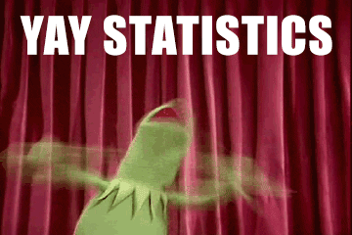

Slide 3
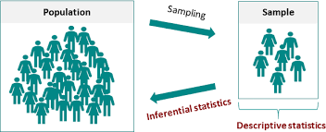
Useful terminology
Hypothesis, H0 HA
Inferential statistics (v descriptive stats EDA) T test, AB test, ANOVA
Level of significance, p-value
Confidence level & interval
Central Limit Theorem

Slide 4

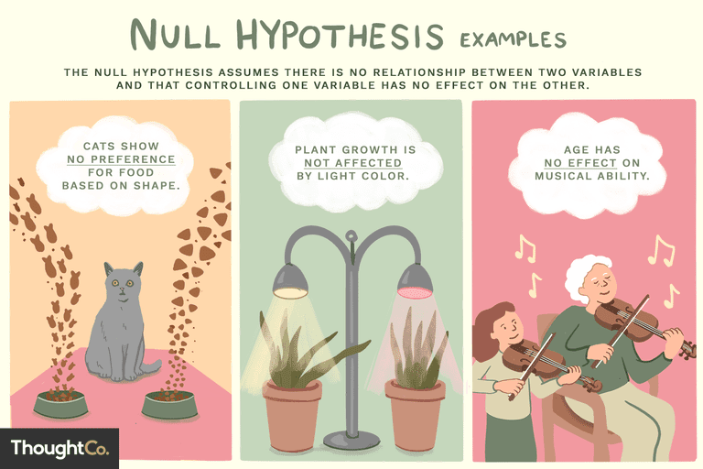

Slide 5
Descriptive Statistics = describes / summarizes the data through some statistics which include mean, median, mode, frequency, standard deviation, and variance. In descriptive statistics, there is no uncertainty as we calculate these statistics on the measured values.
Inferential Statistics = helps us to draw inferences about the population, from the given sample data. The goal is to draw conclusions from smaller number of subjects/samples and generalize them on a larger population (where the complete data is unavailable or unknown)
Notes:
Guidance

Slide 6
inferential statistic methods
The scientific method uses inferential statistics to determine if the independent variable has caused a significant change in the dependent variable and if that change can be generalized to the larger population
To do so we must have a representative data sample
We can propose an insight or prediction based on the sample data
We can also conduct a hypothesis test(/statistical test) to find evidence that sample evidence can be used to support some inference

Slide 7
Inference | Article | Population | Sample | Is the method of statistical inference sound? Is the sampling method representative?
Hegemony of english language is in decline | spotify language use - the economist | Global music streamers | 320k records, 100 popular hits, most streamed song / week, 70 countries, 5 years
NY police are giving incorrect parking fines | Tumblr - open data- nyc parking tickets | NYC parking tickets awarded | 30 parking spots randomly selected where > 5 tickets
3 x variation in bowel cancer death rates between UK areas | Independent blog - inspired by BBC article | Full UK population | Rate per 100k, stats calculated and shared by ONS (UK government agency)
We touch our phones 2,617 times a day on average | Cnbc article summarising studies eg dscout | American smartphone users | 94 android users out of 100k (demographic s.) 5 days, 24 hours
¼ toilets in rural indian schools unusable | Business standard.com ASER survey | All rural schools in india | 17.4k schools, 589 districts

Slide 8
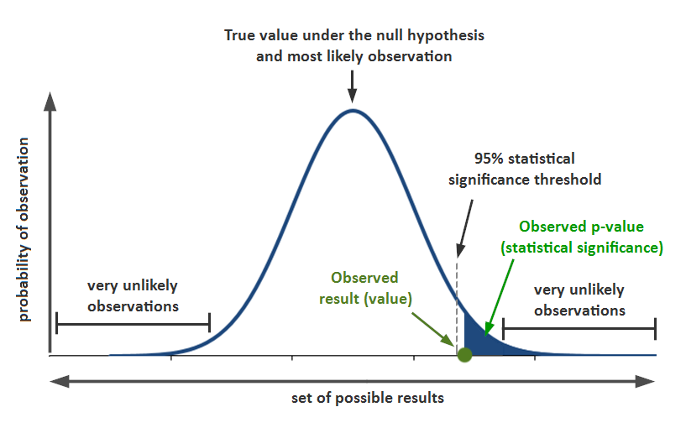
P value

Slide 9
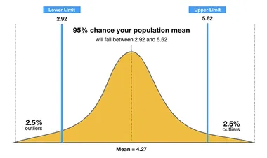
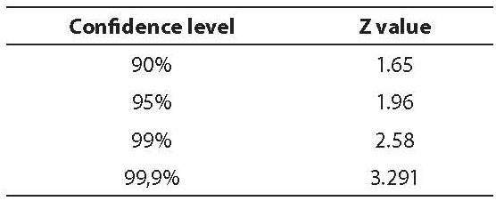
confidence interval

Slide 10
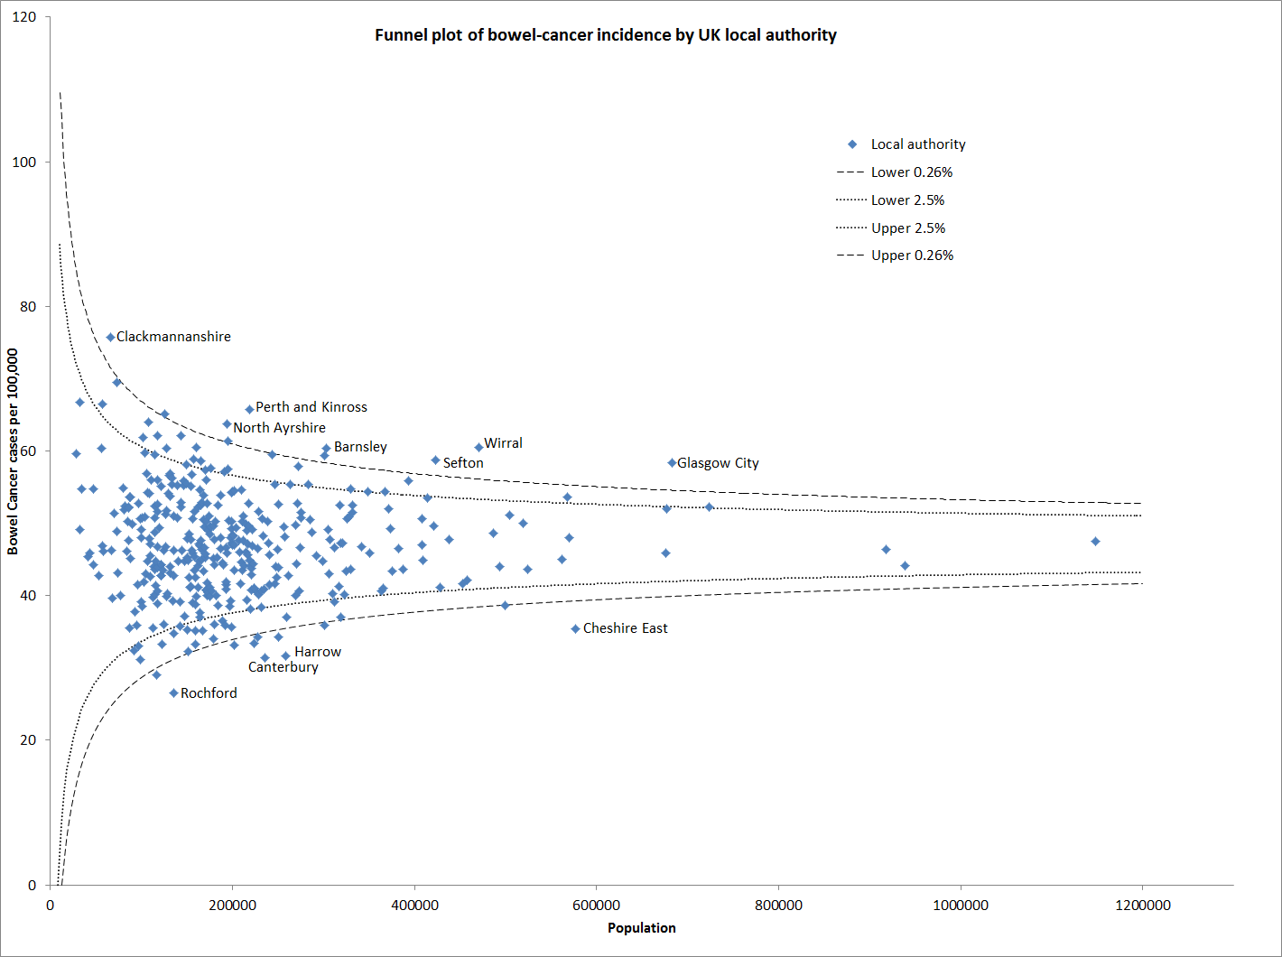
central limit theorem

Slide 11
Inference | Hypothesis test type | Reference mean | Sample | Test fail or succeed
Boys in this school are underweight | T Test | External benchmark +critical value(from t) | 25 boys in one school
This campaign design creates more leads than the other | AB testing | Internal comparison + significance level (from z) | 2 campaigns run at the same time, with same conditions, similar numbers of participants
Vending machine sales alter with different displays | ANOVA test | Internal comparison + significance level (from f) | At least 3 displays trialled in the same time frame, similar conditions

Slide 12
T test
T Test scenario (one tailed)
Boys of a certain age are known to have a mean weight of μ = 85 pounds.
A complaint is made that the boys living in a municipal children's home are underfed.
As one bit of evidence, n = 25 boys (of the same age) are weighed and found to have a mean weight of 80.94 pounds.
sample standard deviation is 11.6 pounds.
Based on the available data, how do we know if the complaint is valid?
Notes:
We do not have the complete data.

Slide 13
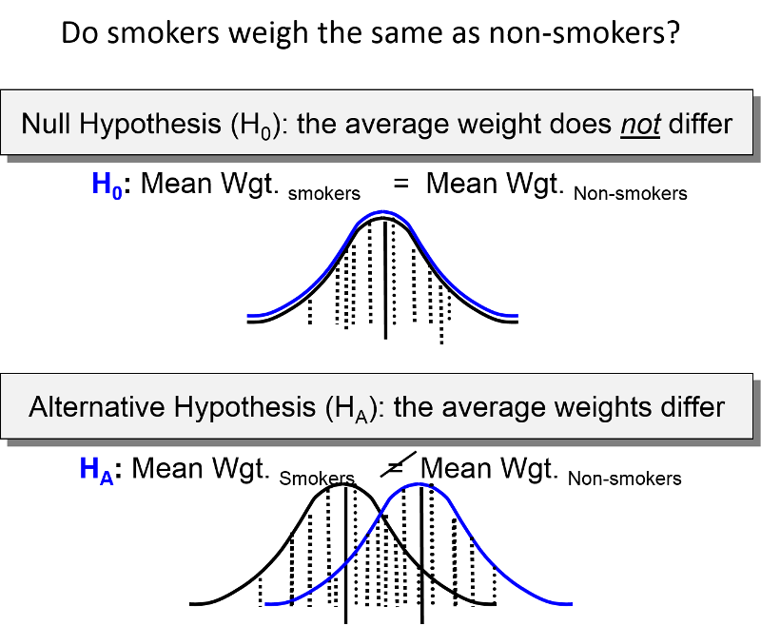
T test

Slide 14
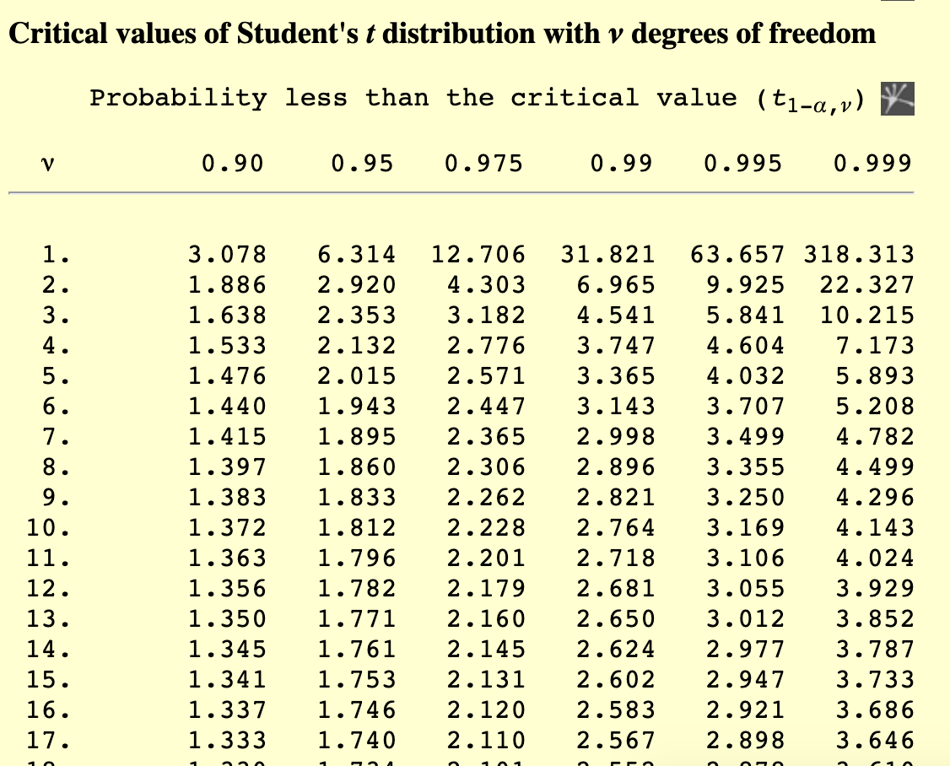
T test value
T test
Degrees of Freedom refers to the maximum number of logically independent values, which are values that have the freedom to vary, in the data sample.

Slide 15
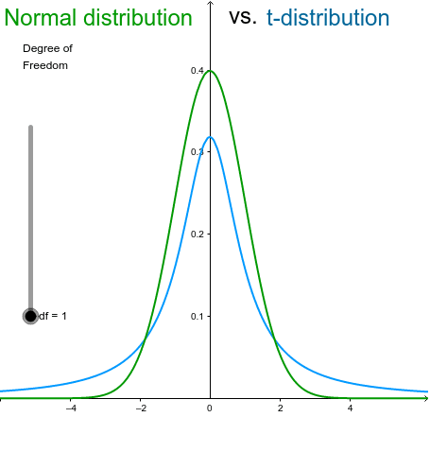
T test
What’s the difference between the t- and z-distributions?
The standard normal or z-distribution assumes that you know the population standard deviation.
The t-distribution (known as the student’s t-distribution) is based on the sample standard deviation.
Notes:
Typically, the degrees of freedom equal your sample size minus the number of parameters you need to calculate during an analysis. It is usually a positive whole number. Degrees of freedom is a combination of how much data you have and how many parameters you need to estimate.
T tables

Slide 16
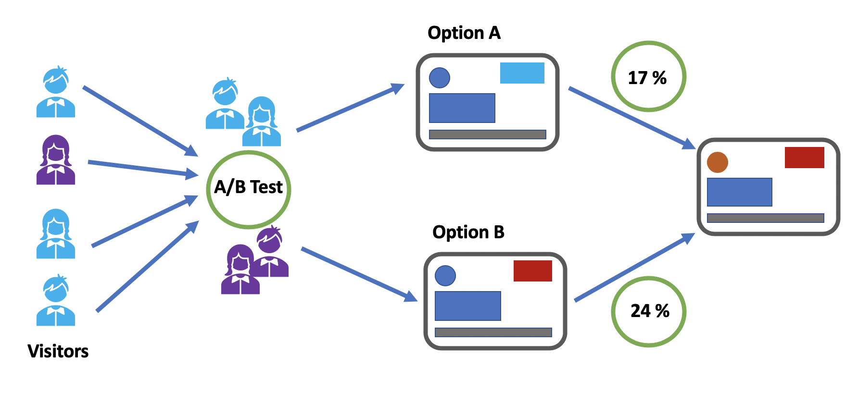
AB test

Slide 17


What is an AB test?
AB test
An A/B test is a randomized experiment, in which the "A" and "B" refer to 2 variants, undertaken in order to determine which variant is the more "effective.". This is popular in web analytics and mobile application development

Slide 18
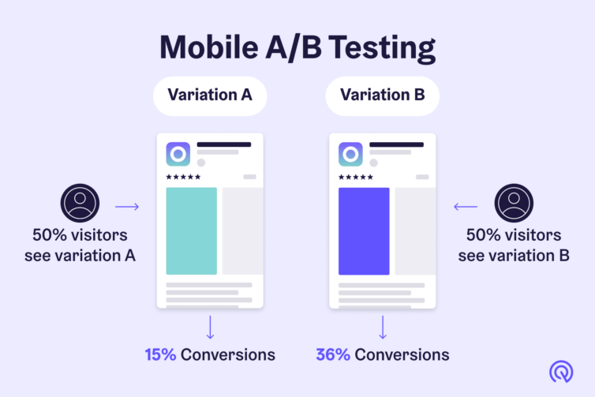
AB test

Slide 19
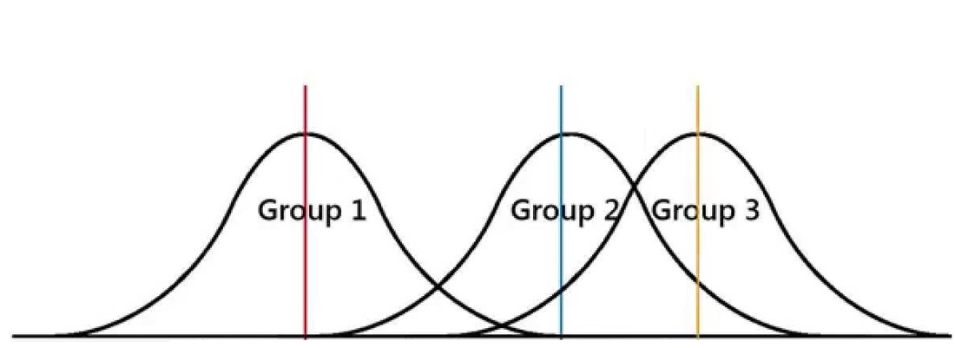
ANOVA test
A technique to compare if there is a substantial difference between the means of three or more samples
Samples may have been treated differently

Slide 20
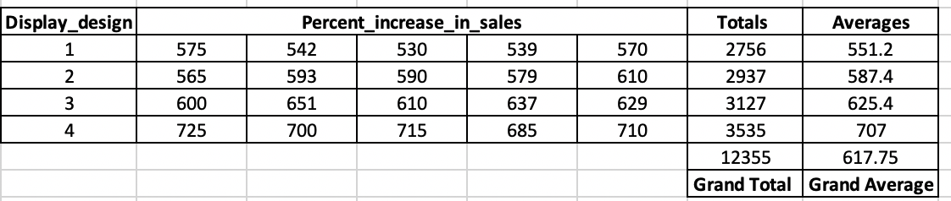
ANOVA test
Example : You are working as an analyst for a soft drink distributor. The regional manager thinks that display design near the product stocks have an effect on the sales of the product. The design team designed four new display and they want to see their effectiveness. These displays were used at different stores and increase in sales were recorded, in the same time frame. Data was collected and it was provided to you. Your task is to conduct statistical test on this data and check if display signs impact sales or not.

Slide 21
ANOVA test
Step 1: Define the null hypothesis - H0: μ1 = μ2 = ...... = μk where k is the number of levels- "display design" in our example. k = 4 in this case - design 1, design 2, design 3, design 4. Means are equal.
Step 2: Define the alternative hypothesis- Ha: not all means are equal.
The null hypothesis is rejected if there is a difference in the means of any of the groups. All the group means need not be different from each other. In our case, even if means for design 1 = design 2 but design 2 != design 3, then we should still reject the null hypothesis.
This is a one way ANOVA test - is there any difference between the means ?

Slide 22
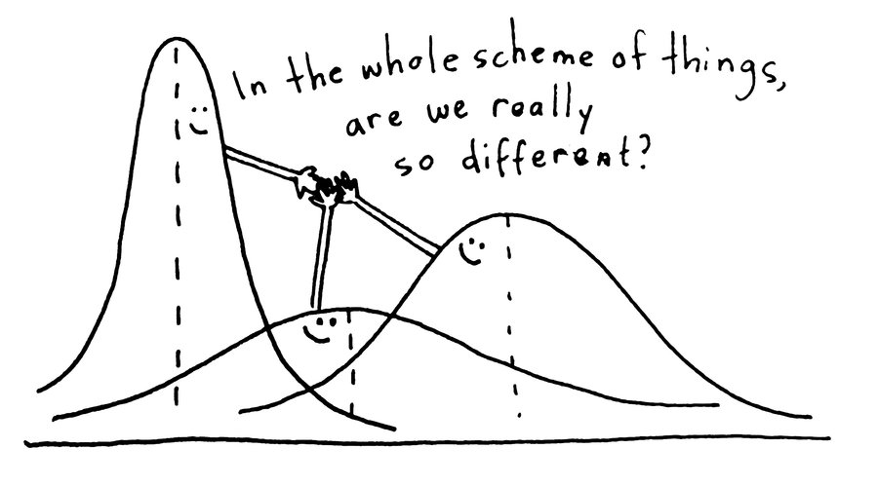
ANOVA test
- ANOVA is similar A/B testing except that here we are testing more than two groups.
- Importantly, the one way ANOVA test tell us if there is a significant difference in the means of any two groups but it does not tell us which pair

Slide 23
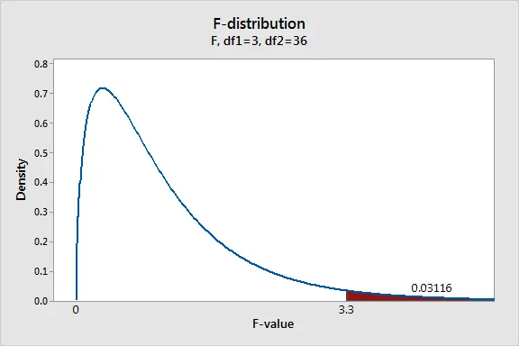
ANOVA test
Step 3:
Level of significance:
Here also we will take it to be 0.05
Test statistic:
for ANOVA, we calculate F statistics based on F distribution
Notes:
Degrees of Freedom
Calculation of Mean square values (Ratio of Sum Square and DoF)
Calculating F Statistics using Mean Square Values
Checking the critical value using degrees of freedom, and significance level alpha.

Slide 24
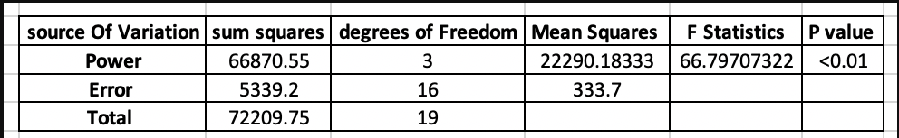
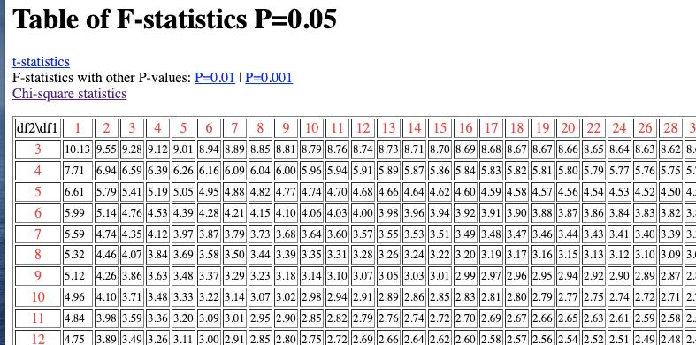
ANOVA test
Notes:
We go across for the first DF and down for the second DF to get the f value (critical value)
Degrees of Freedom
Calculation of Mean square values (Ratio of Sum Square and DoF)
Calculating F Statistics using Mean Square Values
Checking the critical value using degrees of freedom, and significance level alpha.

Slide 25
ANOVA test
Step 4: evaluation
If F statistic > critical value, we reject the null hypothesis (as we would be in the rejection region)
From F Statistic we can also calculate the `p-value`.
If p-value <0.05, reject the null hypothesis
Notes:
Degrees of Freedom
Calculation of Mean square values (Ratio of Sum Square and DoF)
Calculating F Statistics using Mean Square Values
Checking the critical value using degrees of freedom, and significance level alpha.

Slide 26
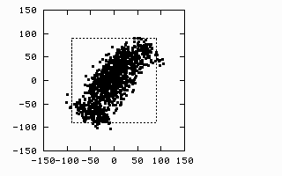
ANOVA test
Notes:
Degrees of Freedom
Calculation of Mean square values (Ratio of Sum Square and DoF)
Calculating F Statistics using Mean Square Values
Checking the critical value using degrees of freedom, and significance level alpha.

Slide 27




Slide 28
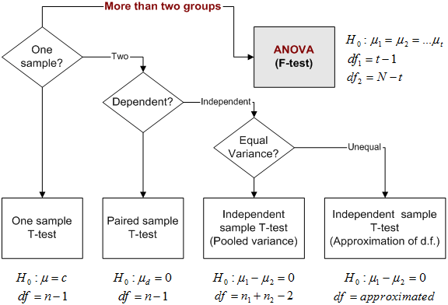

Slide 29
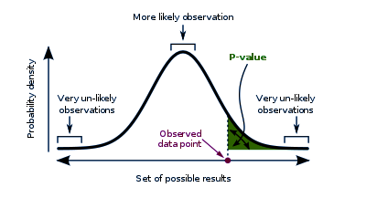
What have we learned ?

Slide 30


